Slide 1
D2 condensation

Slide 2
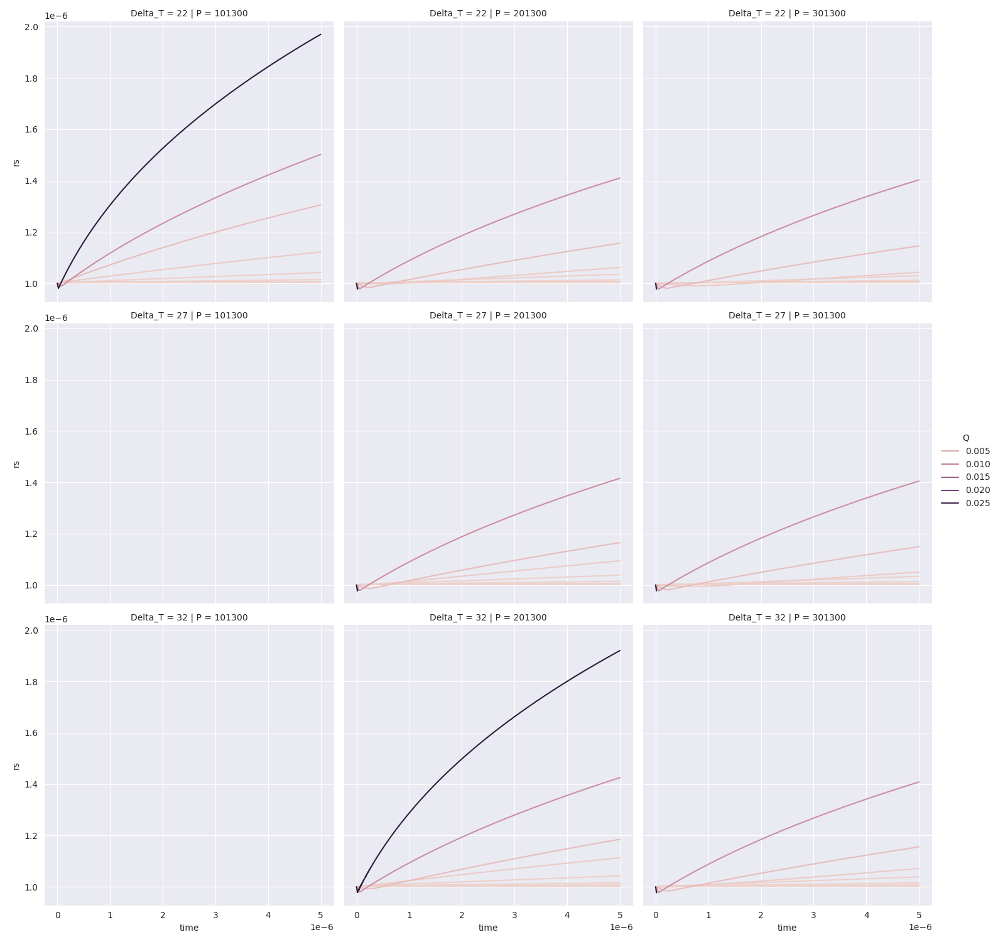
r_s
No Solution found
No Solution found

Slide 3
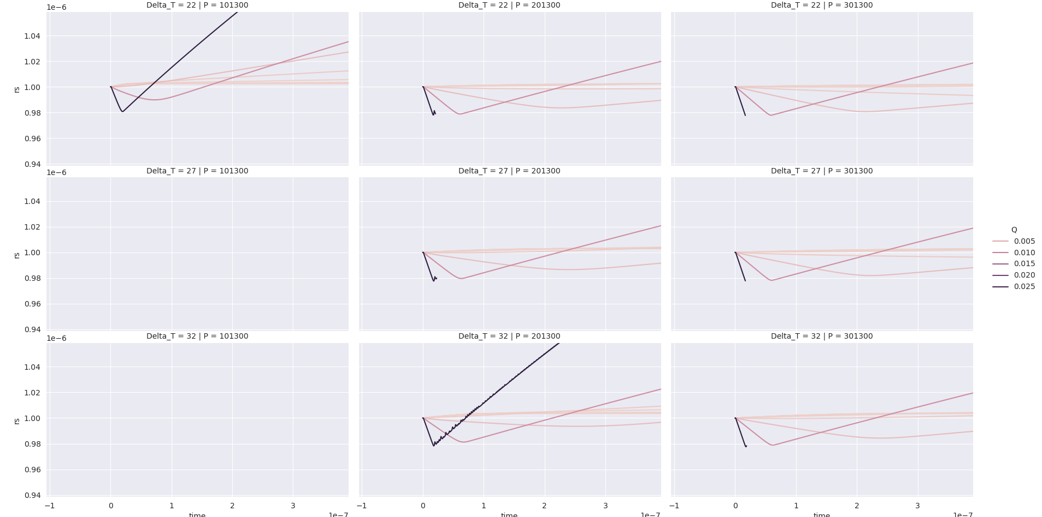
r_s zoom in

Slide 4
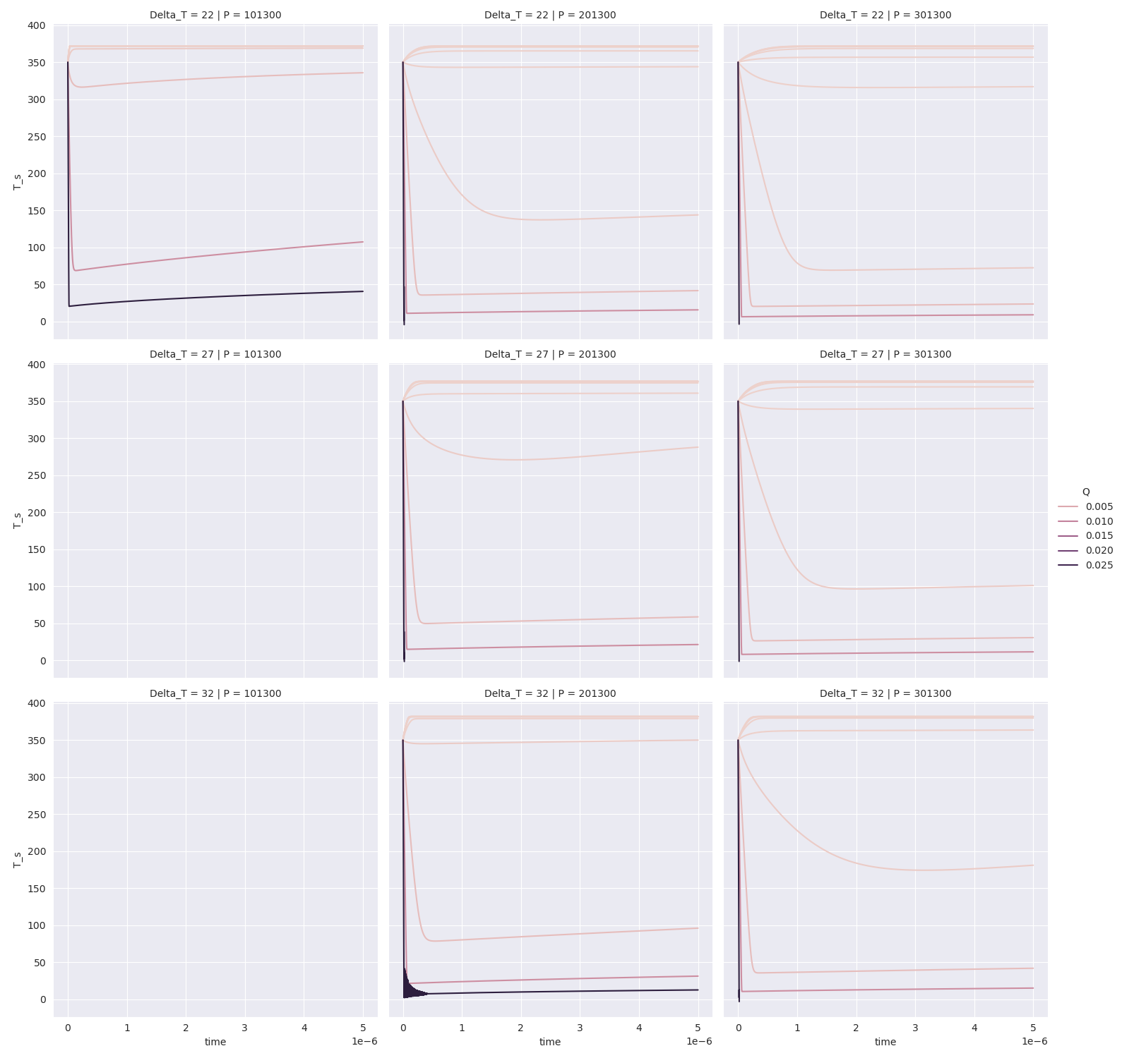
T_s
No Solution found
No Solution found

Slide 5
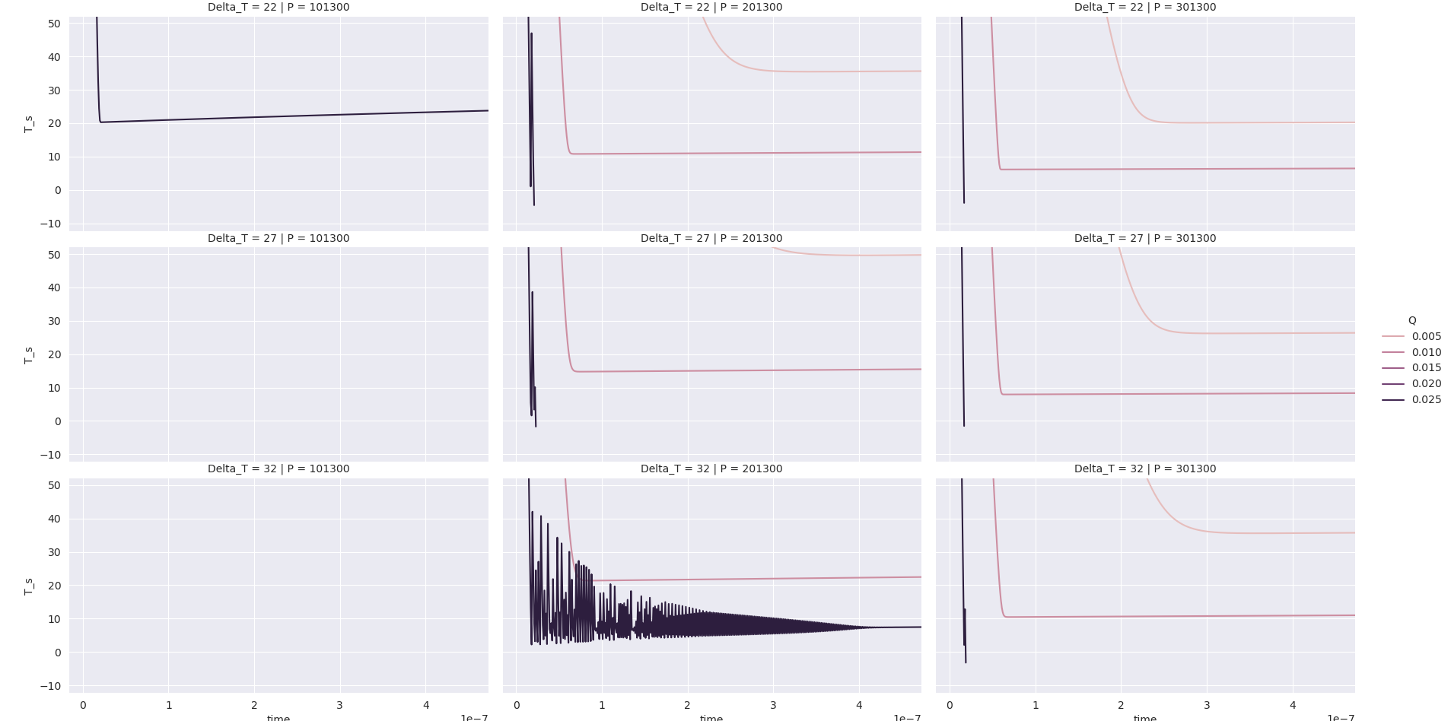
T_s zoom in

Slide 6
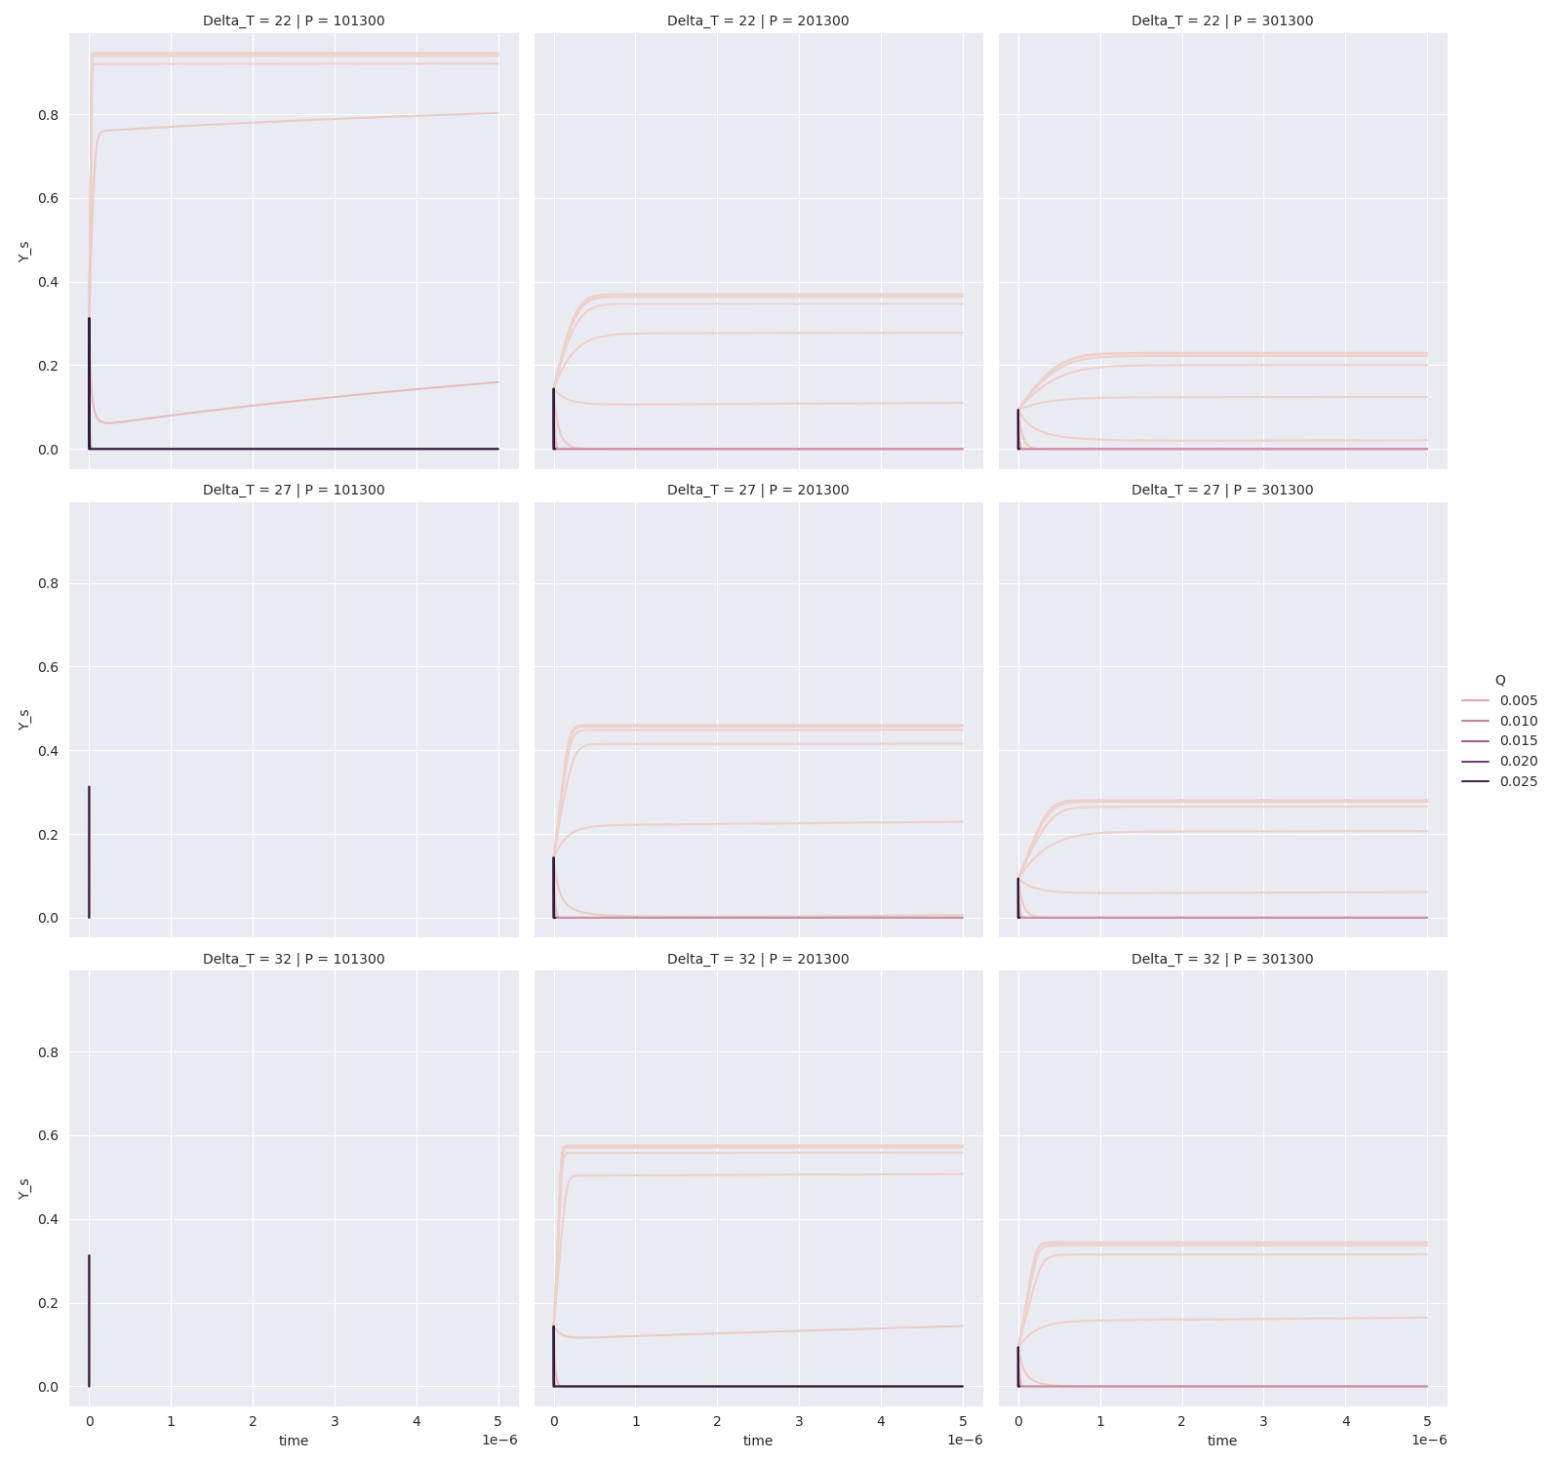
Y_s

Slide 7
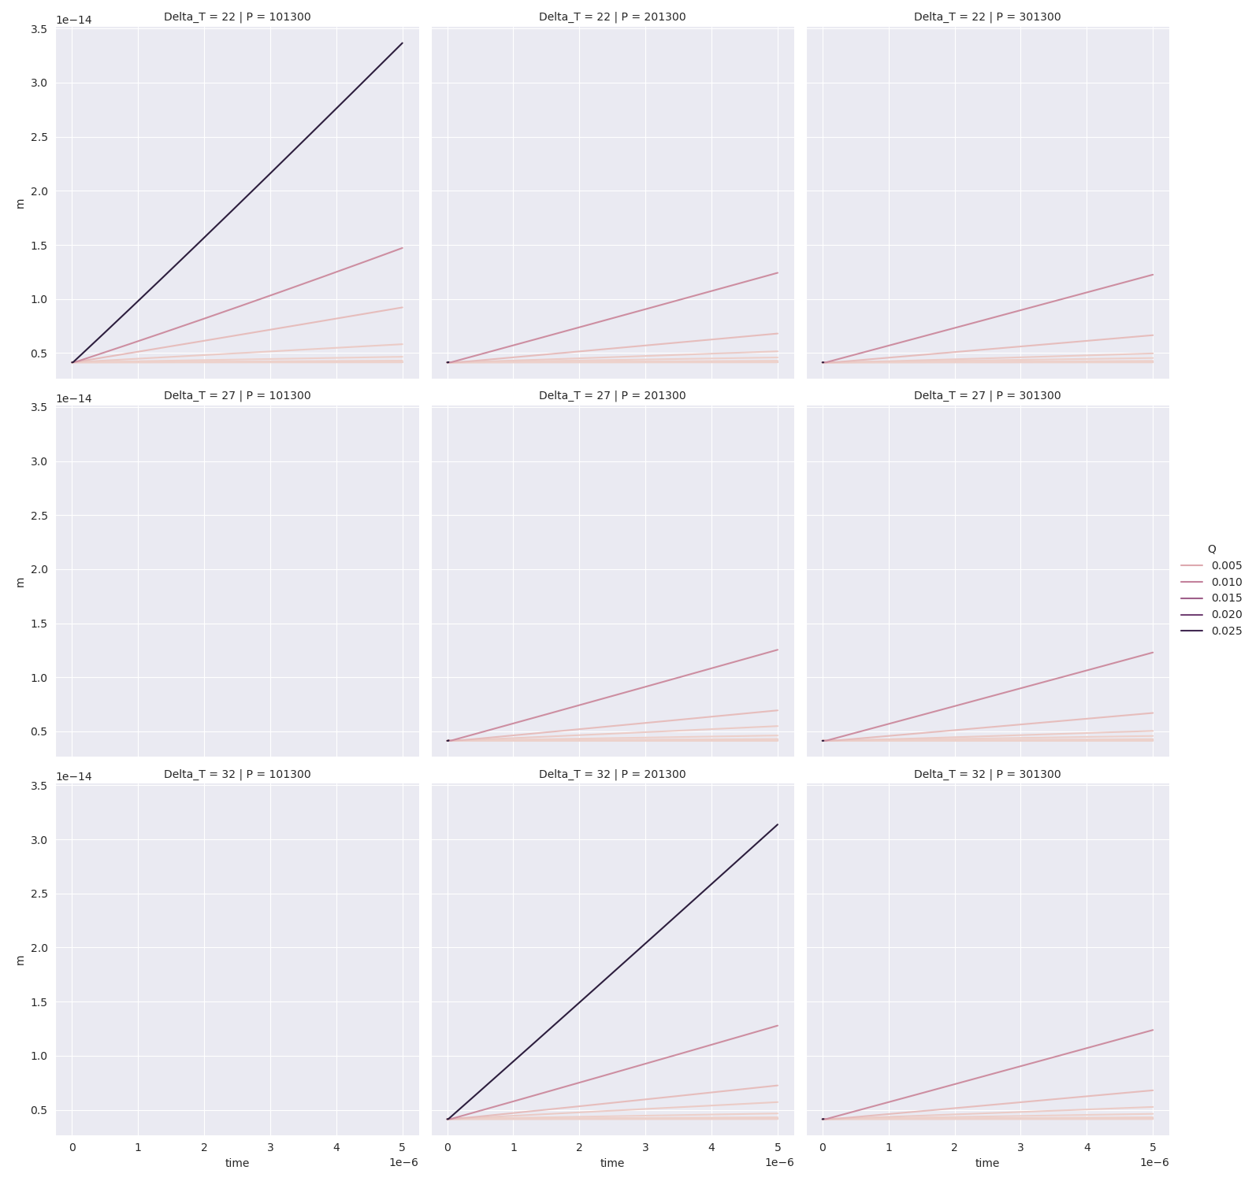
m
No Solution found
No Solution found

